Slide 1
International Business
22MBA401
CORE SUBJECT
                Course Coordinator:
                Prof. Madhunayaka
                Assistant Professor,
                Department of MBA,
                VVIET , Mysuru

Slide 2
Module-4 (7Hours)
International Institutions: UNCTAD- Introduction, Principles and achievements, IMF-Role and objectives, WTO-Role and advantages, TRIMS, TRIPS Features, Economic Integration-Introduction, Levels of Economic Integration, Regional Economic Integration in Europe, USA, ASEAN, SAARC, SAPTA.
Contents of MODULE - 4

Slide 3
International Institutions:
An organization which combines two or more countries as its members for a mutual financial concerns regulated by central body form an international economic institution.
Major International regulatory bodies are as follows:
WTO (World Trade Organization)
UNCTAD(United Nations Conference on Trade and Development)
World Bank
IMF(International Monetary Fund)

Slide 4

UNCTAD
UNCTAD, the United Nations Conference on Trade and Development, is a permanent intergovernmental body within the United Nations Secretariat. Established in 1964, it serves as the UN's focal point for dealing with trade and development issues, as well as related areas like finance, technology, investment, and sustainable development. UNCTAD's primary goal is to promote the integration of developing countries into the global economy in a way that fosters development. (1st Coreference, 1964, Place Geneva)
Objectives of UNCTAD
Promoting inclusive and sustainable growth.
Facilitating trade and investment.
Supporting development-centered globalization.
Addressing development challenges.
Strengthening international cooperation.

Slide 5
Principles
UNCTAD, the United Nations Conference on Trade and Development, operates on several core principles.
These include:
Fostering demand-driven technical cooperation.
Emphasizing country ownership of development initiatives, and ensuring transparency.
Efficiency, effectiveness, and accountability in its work.
UNCTAD promotes sovereign equality, the peaceful settlement of international disputes, and the fulfillment of obligations in good faith.

Slide 6
Achievements
Tariff Reclassification
Integrated Programme on Commodities
Reducing Debt Burden
Commodity Development Facility

Slide 7
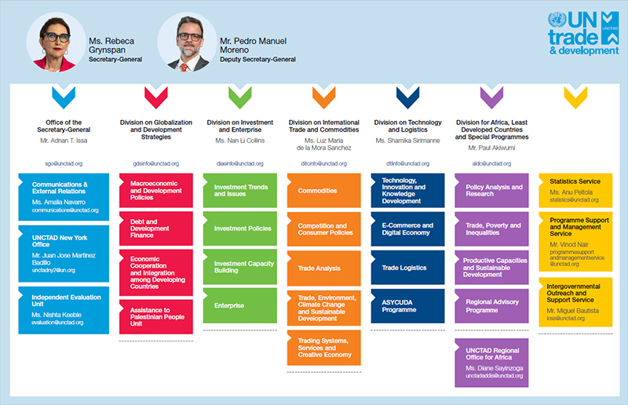
Organizational Structure

Slide 8

IMF
The IMF was formally established on December 27, 1945, when 29 nations signed the Articles of Agreement. However, its financial operations commenced on March 1, 1947. The IMF was conceived at the Bretton Woods Conference in 1944.
Objectives of IMF
To Promote Global Monetary Cooperation
To Facilitate the Growth of International Trade
To Promote Exchange Stability
To Assist in the Establishment of Multilateral system of Payments
To Give Confidence to the Members
To deal with Disequilibrium in the International Balances of Payments.

Slide 9
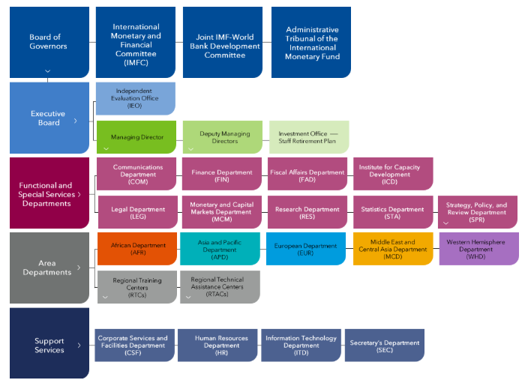

IMF- Organizational Structure
  Ms. Kristalina Georgieva, from Bulgaria, is Managing Director and Chairman of the Executive Board from October 1, 2019.

Slide 10
IMF-Role/Functions
The International Monetary Fund (IMF) plays a crucial role in maintaining global economic stability. Its primary functions include surveillance, financial assistance, and capacity development. The IMF monitors economies, provides policy advice, and offers financial support to countries facing economic difficulties, particularly balance of payments problems. It also fosters international monetary cooperation and promotes sustainable economic growth.
Surveillance
Lending
Technical Assistance

Slide 11
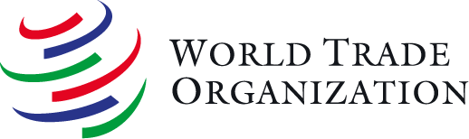
WTO
The World Trade Organization (WTO) is the only global international body dealing with the rules of trade between nations. It aims to ensure that trade flows smoothly, predictably, and freely, ultimately contributing to increased living standards, job creation, and improved lives for people worldwide.
Historical Context:
The WTO was established on January 1, 1995, as a successor to the General Agreement on Tariffs and Trade (GATT), which had primarily focused on trade in goods.
The WTO expanded the scope of international trade rules to include services and intellectual property, as well as introducing new dispute settlement procedures.

Slide 12
Objectives of WTO
1. Administering Trade Agreements:
2. Providing a Forum for Negotiations:
3. Resolving Trade Disputes:
4. Monitoring Trade Policies:
5. Assisting Developing Countries:
6. Promoting Free and Fair Trade:
7. Enhancing Transparency and Predictability:
8. Cooperating with Other Institutions:

Slide 13
Principles of WTO
1.Non-Discrimination:
2. Market Access:
3. Fair Competition
4. Transparency:
5. Reciprocity:
6. Special and Differential Treatment for Developing Countries:
7. Safety Valves:

Slide 14
Role/Functioning of WTO
Helping Developing and Transition Economies
Specialized Help for Export
WTO in Global Economic Policy-Making
Taking Information
Giving information to Public
Encouraging Development and Economic Reforms

Slide 15
WTO advantages
Promoting International Peace
Rules Make life Easier for All
Reducing the Cost of Living
It Provides more Choice of Products and Qualities
Trade Raises the Level of Income and Economic Growth
Achieving Full Employment
Governments are Protected from Lobbying
System Promotes Good Governance

Slide 16
TRIMS
Trade-Related Investment Measures is one of the four principal legal agreements of the WTO trade treaty. TRIMs are rules that restrict preference of domestic firms and thereby enable international firms to operate more easily within foreign markets.
Features of TRIMS
It only applies to investment measures related to goods trade.
This doesn't apply to service trade.
It doesn't regulate the entry of foreign industry or investment.
It is about the discriminatory treatment of imported/exported products.
Concern measures were applied to both foreign domestic firms.

Slide 17
TRIPS
The Agreement on Trade-Related Aspects of Intellectual Property Rights (TRIPS) is a comprehensive international agreement administered by the World Trade Organization (WTO) that sets minimum standards for intellectual property rights (IPR) protection and enforcement. TRIPS aims to reduce trade distortions and obstructions caused by inadequate IPR protection, ensuring measures for enforcing IPRs don't hinder legitimate trade. It also aims to facilitate international trade in knowledge and resolve trade disputes related to IP.
IPRs: Major Concern in TRIPS
Patents
Copyrights
Industrial Design
Trademarks
Geographical Indications
Integrated Circuit Layout Design(IC)
Protection of Undisclosed Information

Slide 18
Regional Economic Groupings/Major Regional Trade Agreements
Regional economic groupings are associations of countries in a geographical region that form agreements to reduce trade barriers and promote economic cooperation, leading to increased trade and investment. Major examples include the North American Free Trade Agreement (NAFTA), now the United States-Mexico-Canada Agreement (USMCA), the Association of Southeast Asian Nations (ASEAN), the European Union (EU), and the Regional Comprehensive Economic Partnership (RCEP). These groupings can range in their level of integration, from Free Trade Areas (FTAs) that eliminate internal barriers, to Customs Unions, Common Markets, and full Economic Unions with integrated economic policies.

Slide 19
Reasons For Formation of Reginal Trading Blocs
Removal of Trade Barriers
Coordination and Bargaining Power
Economic Considerations
Increased returns and Increased Competition
Trade Gains
Investment
Security

Slide 20
Levels of Regional Economic Integration
Political Union
Group of nations with shared sovereignty or complete unification of nations
Economic Union
Common market plus full economic policy harmonization
Common Market
Customs union plus, the free movement goods, service, people, and capital
Customs Union
Free trade are plus a common external tariff
Free Trade Area
Formal tariff-free trading area between countries
Preferential Trading Agreement
Reduced tariffs or special quotas allowing preferential access to markets

Slide 21
Reginal Integration between Countries
Regional Economic Integration in Europe/European Union(EU)
Regional Economic Integration in USA/NAFTA(North American Free Trade Agreement)
ASEAN ( Association of Soth-East Asian Nations)
SAARC ( South Asian Association for Regional Cooperation)
SAFTA ( South Asian Free Trade Area): An Extension to SAARC
BRICS and its Features

Slide 22
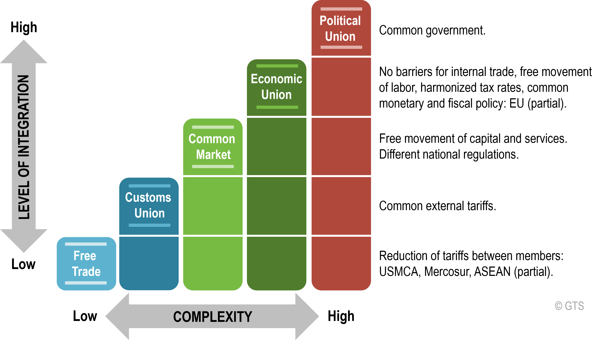
Regional Economic Integration in Europe
Regional economic integration in Europe is most notably represented by the European Union (EU), the world's most integrated economic bloc, characterized by a single market, common currency (the euro), free movement of goods, services, capital, and people, and a customs union with a common external tariff. The process began after World War II with the European Coal and Steel Community and has evolved into a deeply intertwined economic and political union among its 27 member states, serving to promote peace and economic prosperity.

Slide 23
Regional Economic Integration in USA,
Regional economic integration within the United States is not defined by agreements between states as there is already a single, unified national market. Instead, the U.S. participates in regional trade agreements with other countries, such as its participation in the North American Free Trade Agreement (NAFTA-1994-Jan1) and its successor, the United States-Mexico-Canada Agreement (USMCA). These agreements involve the U.S., Canada, and Mexico, focusing on reducing trade barriers and increasing economic cooperation within the North American region.
Functions of Nafta
U.S. Canada Agricultural tariffs
Cannada-Mexico Agricultural tariffs
U.S. Mexico Agricultural tariffs
No-Tariff Barriers
Product Origin
Import Protection

Slide 24
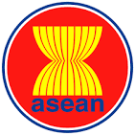
ASEAN(Association of South-East Asian Nations)
The Association of Southeast Asian Nations (ASEAN) is a regional intergovernmental organization of 10 member states in Southeast Asia, founded on August 8, 1967(Bangkok), to accelerate economic growth, social progress, and cultural development, while promoting peace and regional security. Its members are Brunei, Cambodia, Indonesia, Laos, Malaysia, Myanmar, the Philippines, Singapore, Thailand, and Vietnam. The organization's goals include fostering economic integration, ensuring regional stability, and cooperating on matters of common interest through the principle of non-interference in internal affairs.
Objectives:
Promote economic growth, social progress, and cultural development.
Foster regional peace and stability.
Encourage collaboration on common interests.
Maintain close cooperation with other international organizations.

Slide 25

SAARC ( South Asian Association for Reginal Cooperation)
The South Asian Association for Regional Cooperation (SAARC) is a regional intergovernmental organization and geopolitical union of states in South Asia, founded in 1985 to promote the welfare of the peoples of South Asia, accelerate economic, social, and cultural development, and foster collective self-reliance. SAARC has eight member countries: Afghanistan, Bangladesh, Bhutan, India, Maldives, Nepal, Pakistan, and Sri Lanka. Its Secretariat is based in Kathmandu, Nepal.
Key Functions and Areas of Cooperation
Economic Development.
Collective Self-assurance:
Poverty Relief:
Trade: To establish free trade zones, such as the South Asian Free Trade Agreement (SAFTA), and lower trade tariffs to promote intra-regional trade.
Social Progress and Cultural Development:
Technological and Scientific Cooperation:
Human Resource Development:
Environmental and Disaster Management:

Slide 26
SAPTA (SAARC Preferential Trading Arrangement)
SAPTA (SAARC Preferential Trading Arrangement) was a 1993 trade agreement among SAARC member countries (Bangladesh, Bhutan, India, Maldives, Nepal, Pakistan, and Sri Lanka) designed to boost intra-regional trade by gradually reducing tariffs and other barriers. It served as the first step toward a larger Free Trade Area and has since been replaced by the more comprehensive South Asian Free Trade Area (SAFTA) agreement.
SAPTA's key objectives:
Promoting Mutual Trade:
Enhancing Economic Cooperation:
Providing Preferential Treatment:
Laying the Foundation for a Free Trade Area: To serve as the first phase in the process of creating a South Asian Free Trade Area (SAFTA) and, eventually, a Customs Union.

Slide 27
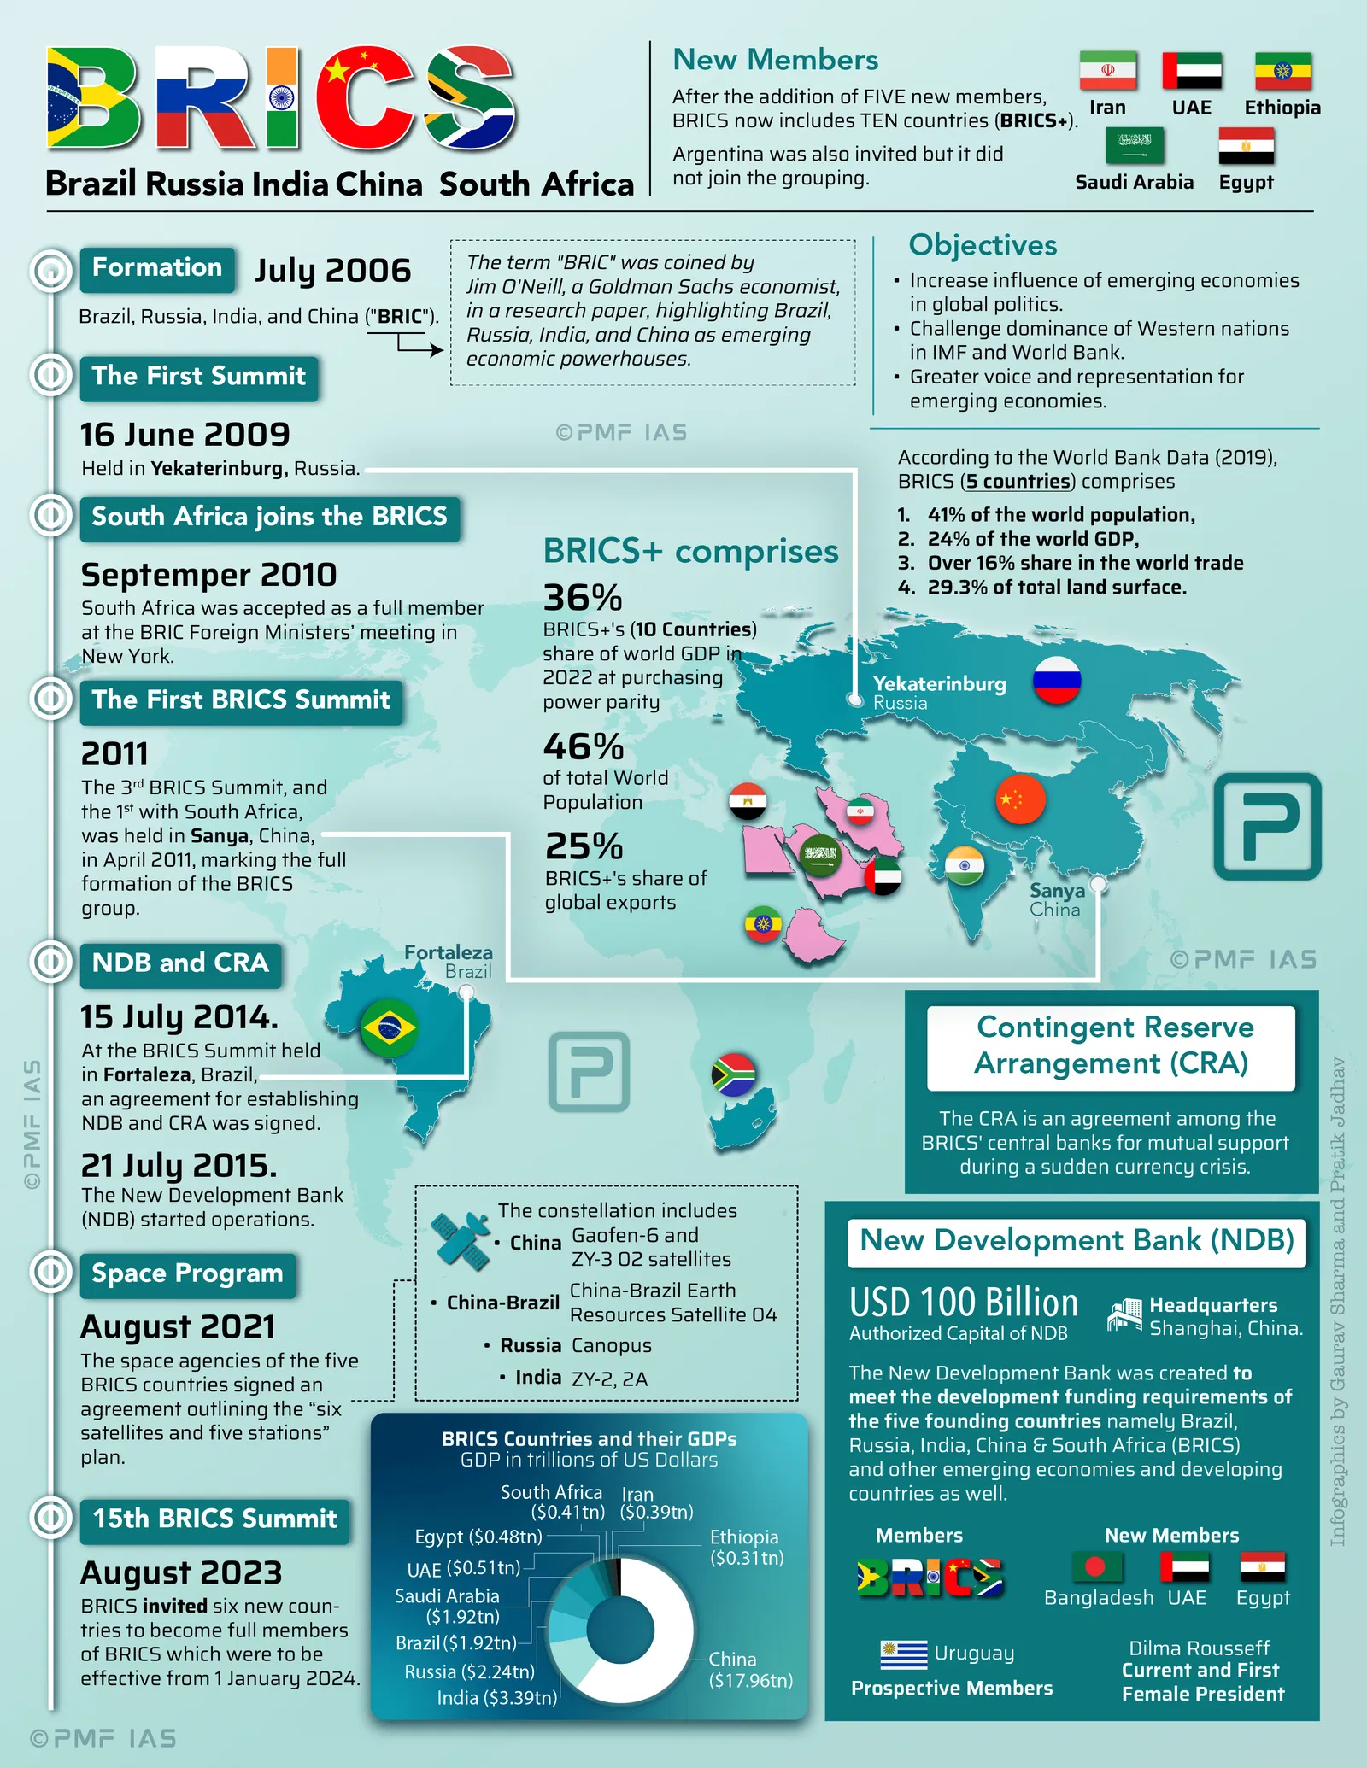
BRICS
BRICS is a geopolitical and economic alliance of major emerging economies, originally an acronym for Brazil, Russia, India, China, and South Africa, which has expanded to include other countries like Egypt, Ethiopia, Iran, Indonesia, and the United Arab Emirates. Its core features include representing a significant portion of the global population and economy, fostering economic and financial cooperation, and challenging Western-dominated global institutions by creating a more multipolar world order

Slide 28
Thank You

